Slide 1
Regular text contrast
That regular sized text is under the 4.5:1 at 2:1 contrast ratio #5692FF →.
This regular sized text is under the 4.5:1 at 3:1 contrast ratio #56C6FF and should fail MS A11y Checker but it’s not for some reason. It does fail in MS Word though 🤷‍♂️.
For some reason, PowerPoint will only pick up contrast issues for text inside a shape or the fill of a table cell.
A11y automated checker | MS Accessibility checker
Detected | Not detected in PowerPoint but is in Word for some reason.

Slide 2
Large text contrast
That regular sized text is under the 4.5:1 at 2:1 contrast ratio #5692FF →.
This regular sized text is under the 4.5:1 at 3:1 contrast ratio #56C6FF.
A11y automated checker | MS Accessibility checker
Detected | Not detected in PowerPoint but is in Word for some reason.

Slide 3
Graphic content contrast
This line chart has graphic elements under 3:1. #F1B4A4 is 1.8:1.
A11y automated checker | MS Accessibility checker
Not detected | Not detected

Slide 4
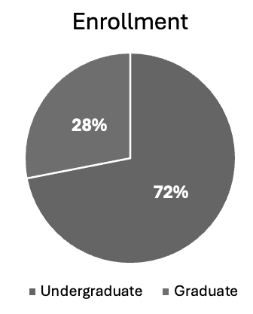
Color used as sole means of communication
Non-conforming example
Achromatopsia emulation
Differentiation between undergrad and grad relies on color alone barring access to people with color vision deficiency.
A11y automated checker | MS Accessibility checker
Not detected | Offers manual testing aid

